Slide 1



Linear Regression
Prediction Face Creams Price
By: Rana Alzahrani

Slide 2
Introduction
- The face cream industry is currently experiencing huge growth.
- The Market looks set to skyrocket as people look for quick and easy solutions.
- Price manipulation
By doing web scrubbing from IHERB.com

Slide 3


Workflow
01
Web Scraping
02
Cleaning the data
03
Linear Regression Model
04
05
Best model
feature engineering

Slide 4
01
Web scraping

Slide 5





Web scraping
• scraped 1000+ product by using BeautifulSoup
product name
Price
Review
Rating

Slide 6
02
Data cleaning

Slide 7
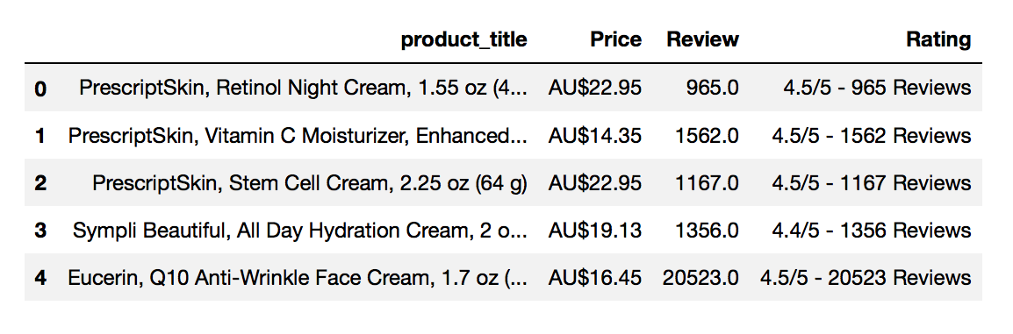
Data cleaning

Slide 8
03
Linear Regression Model

Slide 9
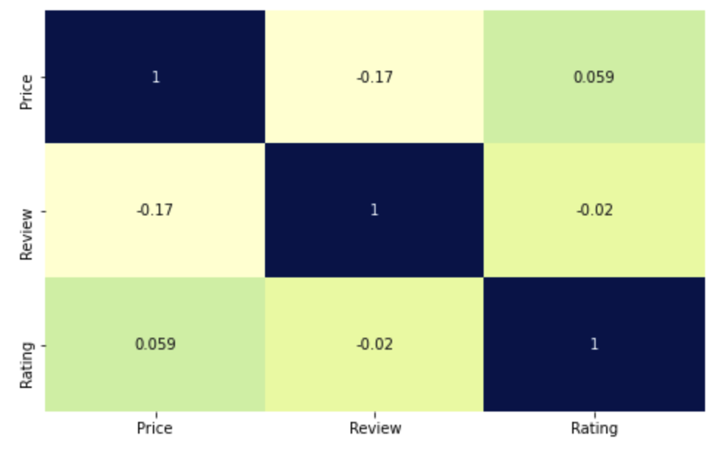
Correlation

Slide 10
04
feature engineering

Slide 11
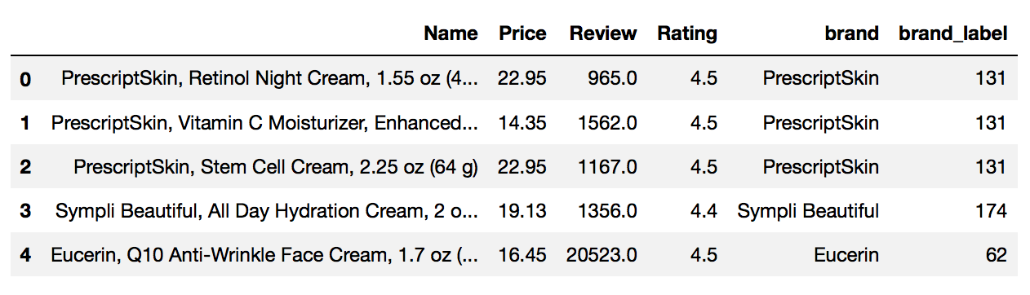
Add New column (brand_label)

Slide 12
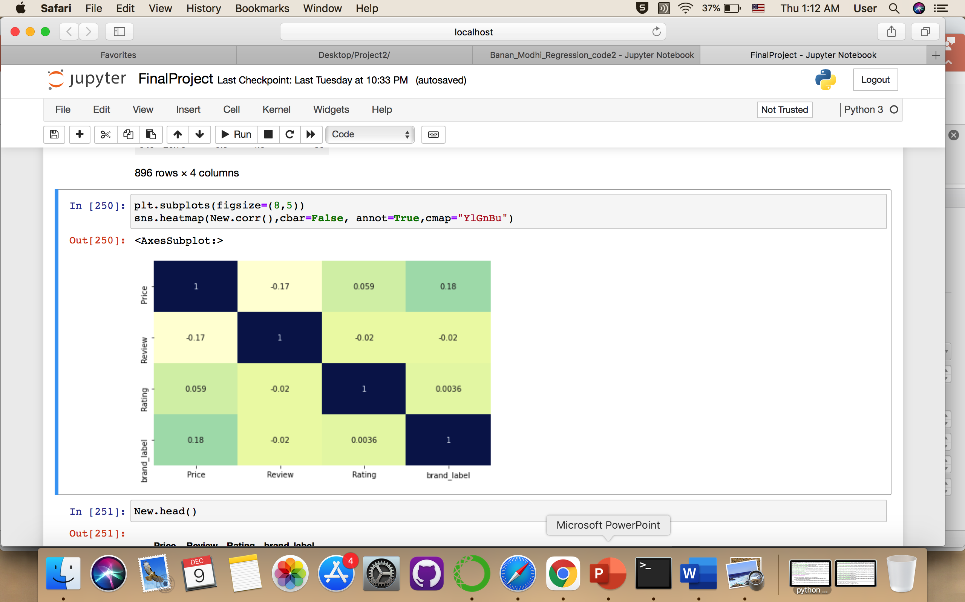
New Correlation

Slide 13
Feature Engineering
First score with out dummy variables for testing : 0.0701
score with dummy variables testing : 0.0904

Slide 14
Result :
Model | Train | Test | Val
Linear Regression | 0.025 | 0.054 | 0.049
Polynomial | 0.038 | 0.090 | 0.074

Slide 15
05
Best model

Slide 16
The chosen model
As we can see here, for the polynomial regression which will give the best test value than from Linear regression and fits the data.

Slide 17
Recommendations
The Polynomial regression best model I prefer to :
Add more features.
Collect more production the data

Slide 18
THANKS

